Slide 1
CSE 191A: Video Game Programming Seminar

Slide 2
Course Info
Steve Rotenberg (srotenbe@cs.ucsd.edu)
CSE 191 A00
http://pisa.ucsd.edu/cse191
2 Units, Pass/No-Pass
Grading: attendance, reading, report
Prerequisites: Computer graphics
Location: Peterson Hall, room 102
Time: Fridays, 5:00-6:20, April 4-June 6
Office: AP&M 3832, Fridays 3:30-4:30

Slide 3
Assignments
Attendance (must attend 9/10 lectures)
Reading (from “Real-Time Rendering”)
Report (2 page report on some special topic of your choice, but you must get my approval on the topic first)
Optional programming

Slide 4
Books
“Real-Time Rendering”, Moller, Haines
“3D Game Engine Design”, Eberly
“Game Programming Gems 1-3”
“Computer Graphics: Principles and Practice”, Foley, Van Dam
“Fundamentals of Computer Graphics”, Shirley
“Physics for Game Programmers”
“Dynamic Simulation of Multibody Systems”, Coutinho

Slide 5
Resources
Game Developer’s Conference
Game Developer Magazine
www.gamasutra.com
DICE Conference
AIAS (www.interactive.org)
IGDA (www.igda.org)
E3 (Electronic Entertainment Expo)

Slide 6
Course Outline
Introduction
Culling & Scene Management
Collision Detection
Physics Simulation
Character Animation
Play Control & Game Design
Artificial Intelligence
Visual Effects
Audio & User Interface
Game Integration

Slide 7

Angel Studios
Movies:
  The Lawnmower Man
  Enertopia (stereoscopic IMAX)
Videos: Peter Gabriel’s “Kiss That Frog”
Games:
  Midnight Club 1 & 2 (PS2, XBox)
  Transworld Surf (PS2, XBox, GameCube)
  Smuggler’s Run 1 & 2 (PS2, XBox, GameCube)
  Midtown Madness 1 & 2 (PC)
  Savage Quest (Arcade)
  Test Drive Offroad: Wide Open (PS2)
  N64 version of Resident Evil 2 (N64)
  Ken Griffey Jr.’s Slugfest (N64)
  Major League Baseball Featuring Ken Griffey Jr. (N64)
Sold to Take Two Interactive (Rockstar) in November, 2002

Slide 8
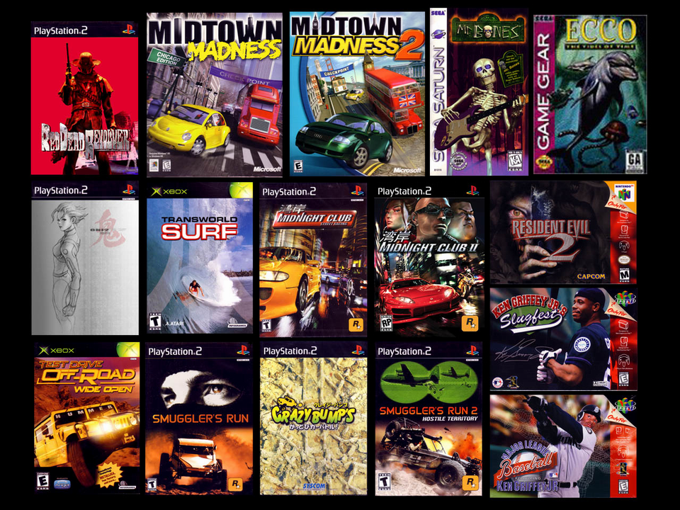
Angel Games

Slide 9
Game Platforms

Slide 10
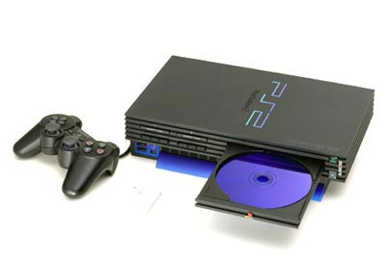
Sony Playstation 2
CPU: 300 MHz MIPS 5000 variant
2 Vector Units: 4 FP MUL/ADDs (+ DIV)
Graphics: Custom GS chip
Audio: Custom DSP chip, 48 voices
Memory: 32 megs + 4 video + 2 audio
DVD drive
Installed: >30 million
Custom graphics APIs

Slide 11
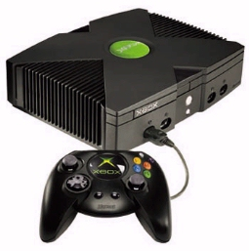
Microsoft XBox
CPU: 733 MHz Intel Pentium 3 variant
Graphics: nVidia GeForce 3 variant
Audio: 256 voices (64 3D voices)
64 megs shared memory
DVD drive
8 gigabyte hard drive
Installed: >5 million
Uses DirectX, Direct3D

Slide 12
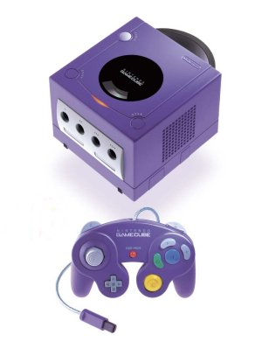
Nintendo GameCube
CPU: 405 MHz Motorola PowerPC variant
Graphics: Custom (6-12 Mtris/sec)
Audio: 16 bit DSP (64 voices)
24 megs main memory + 16 megs audio/misc.
Proprietary mini DVD drive
Installed: ~5 million
Uses a variant of OpenGL

Slide 13
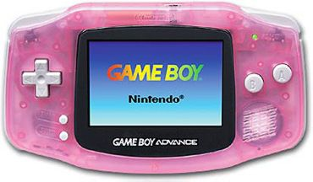
Nintendo GameBoy Advance
32-bit ARM CPU
32K RAM, 96K VRAM, 256K WRAM
240 x 160 pixels, 32,768 colors

Slide 14
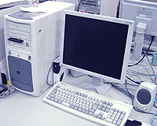
PC
Wide range of CPUs
Wide range of graphics cards
Wide range of audio cards
Wide range of memory
Wide range of devices
Wide range of operating systems
DirectX, OpenGL
Installed base: 100’s of millions

Slide 15

Other Platforms
Apple, Linux
Cell phones, PDAs, etc.
Sega Dreamcast
Sony PS1
Nintendo 64
Classic machines
Arcade
Location based entertainment (LBE)
Interactive theater

Slide 16
Future Game Machines
Playstation 3
XBox 2
HDTV
Ray tracing & photon mapping hardware
Broadband networks
Future input / output devices

Slide 17
Sony Playstation 2 Architecture

Slide 18
PS2 Chips
EE: Emotion Engine
GS: Graphics Synthesizer
IOP: Input / Output Processor
SPU: Sound Processing Unit

Slide 19
Emotion Engine Components
MIPS R5000 core
VU0 & VU1: Vector Units
GIF: Graphics Interface
DMAC: DMA Controller
IPU: Image Processing Unit
SIF: Serial Interface
INTC: Interrupt Controller
DRAMC: DRAM Controller
TIMER: 4 timers

Slide 20
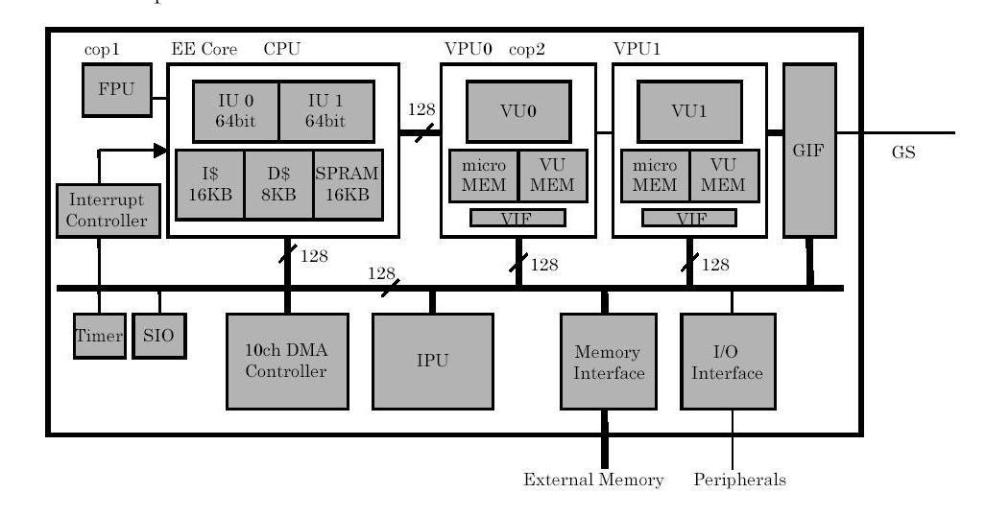
Emotion Engine

Slide 21
EE Core
300 MHz MIPS R5000 CPU
Single floating point multiply/add unit, plus concurrent divider
128 bit integer ALU
16K instruction cache, 8K data cache
16K scratchpad cache
Bus interface
MMU: Memory Management Unit
Core can use VU0 as a vector coprocessor

Slide 22
PS2 Vector Units
2 units: VU0 & VU1 (both are on the EE chip)
Each unit has 32 128 bit vector registers
VU0 has 4 floating point multiply/add units capable of producing a total of 8 results per clock cycle
VU0 also has 1 concurrent divide unit capable of producing 1 result every 7 clock cycles
VU1 has 5 MUL/ADDs and 2 dividers
Each VU has a 16 bit integer control processor that runs concurrently and runs control microprograms
VU0 has 4K code & 4K data memory
VU1 has 16K code & 16K data memory
Both can run as independent processors
VU0 can also run as a coprocessor to the main core
VIF: Vector Interface. Used for unpacking data (positions, colors, normals) sent into the VU’s.
Single precision floating point, non IEEE754 compliant

Slide 23
Emotion Engine Performance
300 MHz
Core/FPU: 1 MUL, 1 ADD, 1/7 DIV
VU0: 4 MUL, 4 ADD, 1/7 DIV
VU1: 5 MUL, 5 ADD, 2/7 DIV
Total: 20 & 4/7 floating point ops per cycle
6.2 GFLOPs peak performance

Slide 24
GS: Graphics Synthesizer
16 parallel pixel units, 8 if using texture mapping
4M of on-chip VRAM (video memory)
Performs triangle filling computations
Features:
  Texture mapping
  Gouraud shading
  Z-Buffer
  Very simple alpha computations
  Not much else…

Slide 25
PS2 Processing Summary
CPU core runs main application program. Most AI, physics, game logic, happen on the core.
CPU core can use VU0 as a coprocessor. Most often, this is the case. This allows the CPU to handle more complex physics and geometric computations efficiently.
VU1 runs as an independent processor and acts primarily as a ‘geometry engine’ for computing transformations and lighting for rendering. VU1 has a direct bus to the GS.
GS handles all pixel processing (Z-Buffer, texture mapping, Gouraud shading) and generates the actual video signal
SPU does audio DSP computations and generates the final audio signal
IOP reads input devices and manages DVD drive
DMAC manages and schedules data movement

Slide 26
Game Development Process

Slide 27
Game Life Cycle
Concept / Experiment / Demo
Prototype
Pre-Production
Production
Testing, Tuning, Debugging
Porting & Localization

Slide 28
Concept, Experiment, Demo
Initial idea used to help ‘sell’ the game and get things started
Might be a 5 page document, or could be a simple interactive demo written in a couple days, or could just be a couple sketches…

Slide 29
Prototype
Initial ‘proof of concept’
Make a demo that shows key concept or concepts
A few people for a few weeks
Might be thrown away

Slide 30
Pre-Production
Very important phase of development
Small team, mostly programmers & designers
Often lasts 6-12 months
Prototype core gameplay mechanics
Set up tools
Define overall goals & processes
Experimentation, trial and error
Goal: get one level fully playable and FUN

Slide 31
Production
Full size team (20, 30, or more)
Produce multiple ‘levels’
Can last 6-12 months (or more…)
Works like a factory
Many people can work in parallel
Follow processes set up in pre-production phase

Slide 32
Testing, Tuning, Debugging
Team shrinks back down (mostly programmers & designers)
Add several full time testers (at least 4)
Lasts 3-6 months
Alpha, Beta, Submission, Gold Master

Slide 33
Porting
Port to secondary platforms
Historically, done after main product ships
More and more simultaneous releases these days
Sometimes, additional levels or features are added
Small team for 3-6 months

Slide 34
Localization
Translate game into different languages
Japanese version
‘European’ version (Spanish, French, German, and possibly others)
Localization usually done after main product ships
Usually only 1 person for 1-2 months

Slide 35
Game Life Cycle
Phases aren’t always distinct
Sometimes, different aspects of the project are in different phases
Different developers have different approaches
Different publishers have different approaches

Slide 36
Runtime Software Systems

Slide 37
General Requirements
Maintain frame rate: usually 30 or 60 fps
Never crash (games are usually ‘soak tested’ for around two weeks)
Tight memory & performance restrictions
Often must work with unreleased hardware and compilers

Slide 38
Low Level Systems
Data structures
Math routines
Memory management
Resources, file IO
Input devices
Widgets, tuning interface
Performance monitoring

Slide 39
Mid Level Systems
Rendering
Audio
Text
Collision detection
Physics
Scripting
Networking
Character animation
Cinematic playback

Slide 40
High Level Systems
Scene management
Play control
Camera
AI (artificial intelligence)
Game logic
Game flow
Lighting, visual effects
HUD
Front end (user interface)

Slide 41
Data Structures
Lists, trees, arrays, hash tables
STL

Slide 42
Math Routines
Vectors, matrices, quaternions
Geometry calculations
Random numbers
Misc. math routines
Must run fast and should take advantage of hardware if possible

Slide 43
Memory Management
Many games use custom memory management routines
Must avoid fragmentation
Layered memory management
Paging

Slide 44
Resources & File IO
Fast loading
Paging
Parsing
File formats
XML
Compression
Resource packing

Slide 45
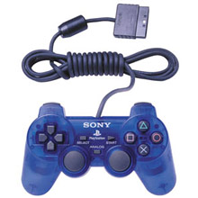
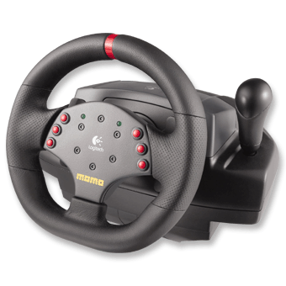
Input Devices
Control pads, joysticks
Keyboard, mouse
Special hardware
Force feedback
Microphone
Camera
Configuration
Button mapping
Calibration

Slide 46
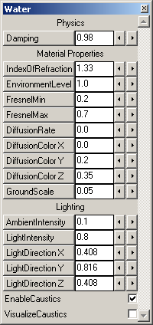
Widgets & Tuning Interface
Tuning & monitoring interface used for development
Run on target and host platforms
In-game picking, manipulation

Slide 47
Performance Monitoring
Time is a critical resource
Various pieces of hardware, each with their own timing & performance characteristics: CPU, graphics, audio, IO
Many sophisticated profilers exist
In-game budgets & warnings
In-game graphing
Output to file for thorough analysis

Slide 48
Rendering
Layer on top of hardware
Common APIs: OpenGL, Direct3D, PS2
Render polygonal meshes (display lists)
Lighting
Graphics state
Matrix & viewing transformations

Slide 49
Audio
3D spatialization: panning, Doppler, Dolby Surround, HRTF (head related transfer functions)
Manage sound priorities (voices)
Reverb, effects
MIDI
Music
Dynamic music
Stream off CD / DVD (multiple streams)
Voice

Slide 50
Tools

Slide 51
Code Development Tools
Compilers (Visual C++, SN Systems, CodeWarrior, GNU)
Debugger
Profiler
Editor
Revision control (CVS, SourceSafe)
Integrated development environment (IDE)
C++, Assembly
Graphics languages: pixel & vertex shaders…
Design analysis tools
Documentation, standards

Slide 52
Middleware
Getting more and more popular and trusted
Rendering: RenderWare, NDL, Intrinsic
Physics: Havok, MathEngine
Engines: Quake, Unreal…

Slide 53
Art Production Tools
3D Modeling & Animation (Maya, 3D Studio)
Exporting
Asset management (AlienBrain)
Paint (2D & 3D) (Photoshop, DeepPaint)
Scanning (2D, 3D)
Motion capture
In-game tools

Slide 54
Audio Tools
Recording
Composing (ProTools)
Sound effects (Reason)
In-game tools

Slide 55
Game Design Tools
In-game tools
Level layout
Prototyping tools (Director)
Design tools

Slide 56
Conclusion

Slide 57
Preview of Next Week
Scene management
Culling
Level of detail
Terrain rendering
Review
  Polygon rendering
  Matrix transformations (4x4 homogeneous)
  Viewing volumes & transformations
  Z-Buffer
  OpenGL and/or Direct3D

Slide 58
Reading Assignment
“Real Time Rendering”
  Read chapter 9
  Review chapters 1-3

